Slide 1
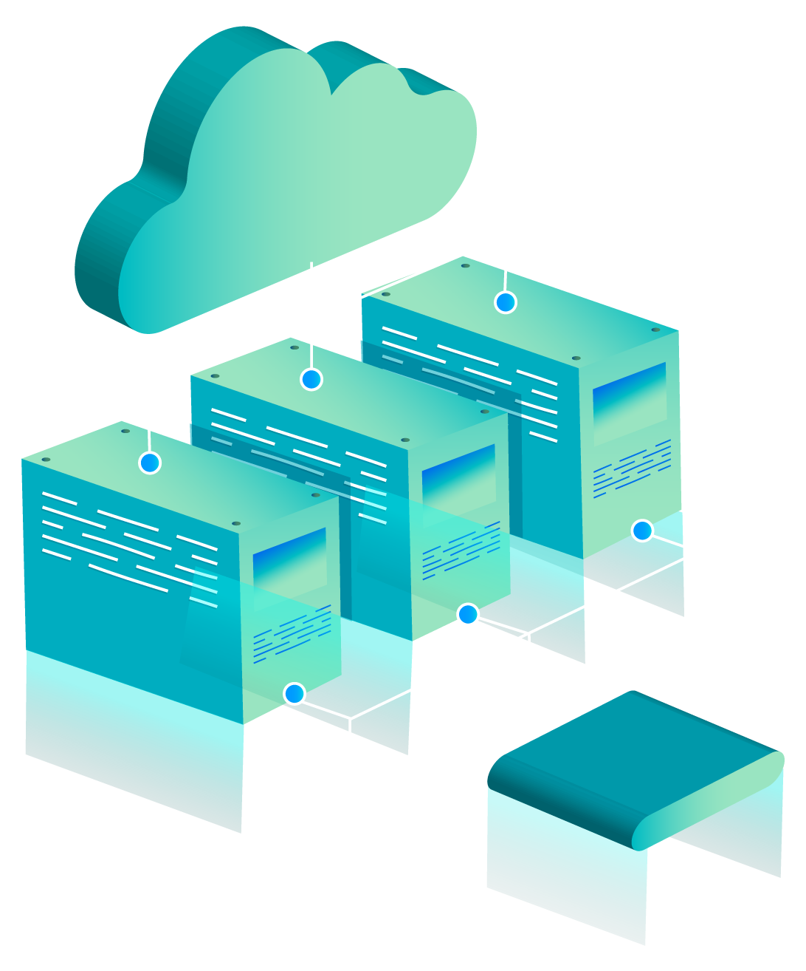

DevOps
Intro
Development Operations
Bat El Peretz

Slide 2
What are we going to talk about today?
01
Devops Role Definition
03
Devops Requirements
02
Devops Work In Practice
04
Summary and Q & A

Slide 3
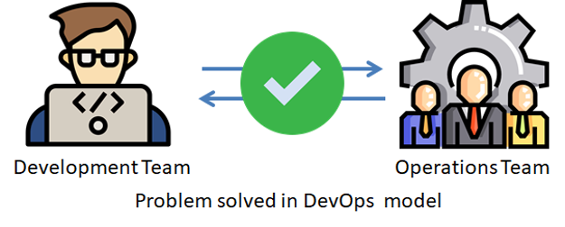
Definition of the DevOps role
The Devops role is a broad and general definition.
In high-tech companies there are programmers, these programmers write code and until it goes out and becomes a product, there is a complete and branching path - for which the DevOps people are responsible.
DevOps is a collaborative culture that enables cross-functional teams to work together to build, test, and deploy software applications faster and more reliably.

Slide 4
DevOps work in practice
This is a position that mediates between the developers and the other departments, the work in each company is expressed differently according to the requirements and nature of the company.
Examples of DevOps work:
Make sure code doesn't go out before it's properly tested by the right people, ship it after testing properly to the production environment.
automating the software delivery pipeline, monitoring and managing infrastructure, and ensuring that applications are highly available, secure, and scalable.
And even when you need to set up infrastructure in the cloud - this is again the work of the DevOps staff!

Slide 5

DevOps work in practice - Netflix
Netflix began experiencing frequent service outages in the early days of their streaming service, which were both costly in terms of lost revenue and damaging to the company's reputation. To address this issue, the company began investing heavily in DevOps practices, including continuous integration, automated testing, and infrastructure automation.
By automating their deployment and testing processes, Netflix was able to reduce the risk of outages caused by bugs or errors in the code. Additionally, by automating the scaling of their infrastructure, they were able to quickly and efficiently respond to increases in traffic, ensuring that their service remained available even during peak usage periods.
Over time, the adoption of DevOps practices has allowed Netflix to significantly reduce the cost of downtime. In 2018, the company reported that they had reduced their outage rate by 90% since 2012, which has resulted in savings of over $1 billion in lost revenue.

Slide 6
DevOps Requirements
Technical position: you need to learn programming languages ​​and know how to deal with technical problems, both on the infrastructure side and on the code side.
Service position: requires working with people constantly
requires exploration and learning: it is necessary to constantly learn new technologies from all kinds of content worlds
It may be a 'One Person Show' - in startups and small companies, there’s one Devops person - maybe two. For this you need a wide world of knowledge, and to know how to do many different and varied things - and do them well!

Slide 7
Summary
In summary, DevOps is a set of practices and methodologies that enable software development teams to deliver software more quickly and reliably. It emphasizes collaboration, automation, and continuous improvement. As a DevOps professional, you will play a critical role in ensuring that software is built and deployed efficiently and reliably.
The whole point in the entire field of DevOps and its various derivatives (DevSecOps, FinOps, etc.), is the matter of self-learning.
The technologies change and are updated all the time, and even if you now "align" all the technologies that exist in the world today, in another six months to a year, a significant part of what you know will be less relevant, if at all.
In short - the most important skill in this field (and in general) is self-learning and dealing with challenges and a dynamic reality.

